Slide 1
Week 4a
COMPUTATIONAL MATHEMATICS

Slide 2

Session Learning Outcomes
Upon completion of this session, you should be able to solve linear algebra problems: $A x = b$.

Slide 3
Reference
Kisualaas, Jann. (2013). Numerical Methods in Engineering with Python 3. Cambridge University Press.
Johansson, Robert. (2015). Chapter 5. Equation Solving. Numerical Python: A Practical Techniques Approach for Industry, Apress.
Chapra, S. C., and Raymond P. Canale. (2010). Numerical methods for engineers, Sixth edition, McGraw Hill.

Slide 4
Topics to be covered
Gauss Elimination
LU decomposition methods
Gauss Jordan Elimination

Slide 5
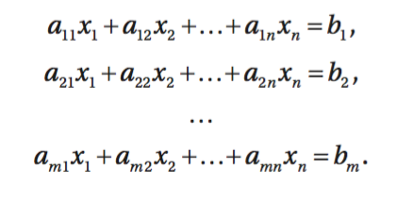
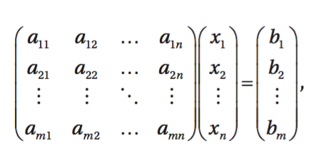
Notation of Linear Equations
A set of n linear equations in n variables, x_{i}
Can be written in matrix form, Ax = b:

Slide 6
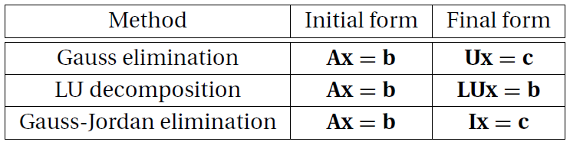
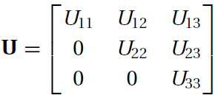
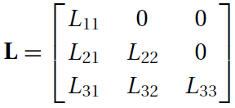
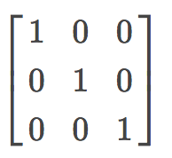
Overview of Direct Methods
The following table lists three popular direct methods, each of which uses elementary operations to produce its own final form of easy-to-solve equations.
In the table, U represents an upper triangular matrix, L is a lower triangular matrix, and I denotes the identity matrix.
I =

Slide 7
Naïve Gauss Elimination
A method to solve simultaneous linear equations of the form [A][X]=[C]
Two steps
1. Forward Elimination
2. Back Substitution

Slide 8
Forward Elimination
The goal of forward elimination is to transform the coefficient matrix into an upper triangular matrix

Slide 9
Forward Elimination
A set of n equations and n unknowns
. .
. .
. .
(n-1) steps of forward elimination

Slide 10
Forward Elimination
Step 1
For Equation 2, divide Equation 1 by and multiply
by .
Equation 1
Equation 2

Slide 11
Forward Elimination
Subtract the result from Equation 2.
−
_________________________________________________
or

Slide 12
Forward Elimination
Repeat this procedure for the remaining equations to reduce the set of equations as
. . .
. . .
. . .
End of Step 1

Slide 13
Forward Elimination
Step 2
Repeat the same procedure for the 3rd term of Equation 3.
. .
. .
. .
End of Step 2

Slide 14
Forward Elimination
At the end of (n-1) Forward Elimination steps, the system of equations will look like
. .
. .
. .
End of Step (n-1)

Slide 15
Forward Elimination

Slide 16
Back Substitution
Solve each equation starting from the last equation
Example of a system of 3 equations

Slide 17
Back Substitution
. .
. .
. .

Slide 18
Back Substitution
Start with the last equation because it has only one unknown

Slide 19
Back Substitution

Slide 20
Example
Solve the system of equations the augmented matrix :
Solution
We introduce a lower triangular matrix, L, to record
row multipliers in the • positions
Calculate the row multipliers and record them in the
L matrix, l₂₁ = a₂₁/a₁₁ and l₃₁ = a₃₁/a₁₁
Zero the first column by subtracting l₂₁ = a₂₁/a₁₁ times the first row from the second row, and subtracting l₃₁ = a₃₁/a₁₁ times the first row from the third row

Slide 21
Example
Calculate the row multiplier and record it in the L
matrix, l₃₂ = a’₃₂/a’₂₂
Zero the second column by subtracting l₃₂ = a’₃₂/a’₂₂ times the second row from the third row, forming an upper triangular matrix
Back Substitution
The last row represents a”₃₃ z = b”₃, so that z = b”₃ / a”₃₃ = –7 / –7 = 1
The second row represents a’₂₂ y + a’₂₃ z = b’₂, so that y = (b’₂ a’₂₃ z) / a’₂₂ = (–6 + 2) / (–2) = 2
The first row represents a₁₁ x + a₁₂ y + a₁₃ z = b₁, so that x₁ = (b₁ – a₁₂ y – a₁₃ z) / a₁₁ = (4 – 2 – 1) / 1 = 1
The solution is thus x = 1, y = 2, z = 1.

Slide 22
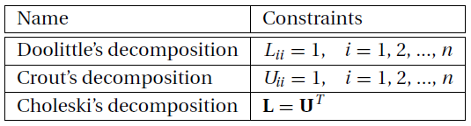
LU Decomposition
Any square matrix A can be expressed as a product of a lower triangular matrix L and an upper triangular matrix U:
A = LU
The process of computing L and U for a given A is known as LU decomposition or LU factorization.
LU decomposition is not unique (the combinations of L and U for a prescribed A are endless), unless certain constraints are placed on L or U. These constraints distinguish one type of decomposition from another. Three commonly used decompositions are

Slide 23
LU Decomposition
After decomposing A, it is easy to solve the equations
Ax = b.
First rewrite the equations as LUx = b.
Upon using the notation Ux = y, the equations become
Ly = b
which can be solved for y by forward substitution. Then
Ux = y
will yield x by the back substitution process.

Slide 24
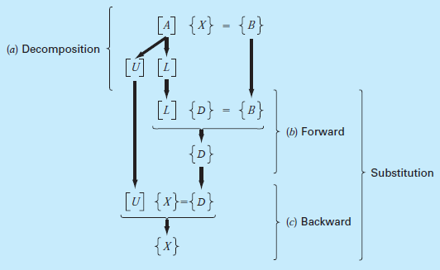
LU Decomposition

Slide 25



Doolittle’s Decomposition Method
Consider a 3 × 3 matrix A and assume that there exist triangular matrices
such that A = LU. After completing the multiplication on the right-hand side, we get
apply Gauss elimination to A. The first pass of the elimination procedure consists of choosing the first row as the pivot row and applying the elementary operations

Slide 26
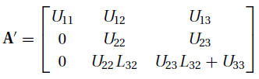


Doolittle’s Decomposition Method
The result is
In the next pass we take the second row as the pivot row and utilize the operation
ending up with
The final form of the coefficient matrix would thus be the following
mixture of L and U:

Slide 27
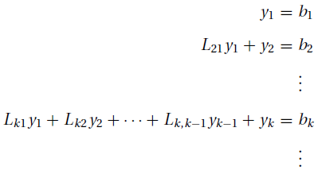

Doolittle’s Decomposition Method
Consider now the procedure for the solution of Ly = b by forward substitution. The scalar form of the equations is (recall that L_{ii} = 1)
Solving the k^{th} equation for y_{k} yields

Slide 28



Example
Use Doolittle’s decomposition method to solve the equations Ax = b, where
Solution
The first decompose A by Gauss elimination. The first pass consists of the elementary operations
Storing the multipliers L₂₁ = 1 and L₃₁ = 2 in place of the eliminated terms, we obtain

Slide 29
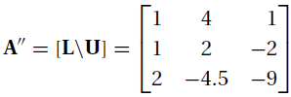
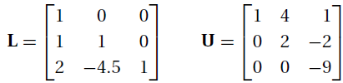

Example
The second pass of Gauss elimination uses the operation
Storing the multiplier L32 = −4.5 in place of A32, we get
The decomposition is now complete, with
Solution of Ly = b by forward substitution comes next. The augmented coefficient form of the equations is

Slide 30
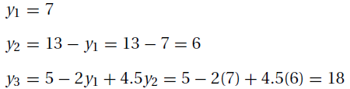
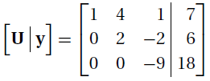
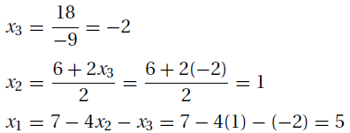
Example
The solution is
Finally, the equations Ux = y, or
are solved by back substitution. This yields

Slide 31
Gauss-Jordan Elimination
The Gauss–Jordan method is essentially Gauss elimination taken to its limit. In the Gauss elimination method only the equations that lie below the pivot equation are transformed. In the Gauss–Jordan method the elimination is also carried out on equations above the pivot equation, resulting in a diagonal coefficient matrix.
Solve
Solution
The augmented matrix of this system is
2x₁ + 3x₂ = 7
4x₁ + 5x₂ = 13

Slide 32
Gauss-Jordan Elimination
a b
c
d
Replace row1 with ¹/₂ * row1 + 0 * row2
Replace row2 with row2 – 4 * row1
Negate row2
Replace row1 with row1 + ³/₂ * row2
Read off solution: x₁ = 2, x₂ = 1

Slide 33
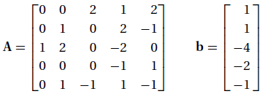


Exercises
Use Gauss elimination to solve the equations Ax = b, where
Use Gauss-Jordan elimination to solve the equations Ax = b, where
Find L and U using Doolittle’s decomposition so that

